Slide 1
Non-invasive ventilation in the NIcu
Ryan Lam
Neonatal-Perinatal Medicine Fellow
March 3, 2016

Slide 2
Conflicts of Interest
I have no financial conflicts of interest to declare

Slide 3
Objectives
Describe the development of the lung and its consequences in preterm infants
Describe how nCPAP can potentially improve outcomes in preterm infants
Describe the different non-invasive ventilation strategies used for respiratory distress syndrome

Slide 4
introduction
Mahmoud et al, 2011
Notes:
Looking at this chart – there are a LOT of non-invasive ventilation modes. Why so many? What’s the drive behind this?
We are looking for ways to treat respiratory distress syndrome and prevent progression to brochopulmonary dysplasia, or chronic lung disease of prematurity. We also want to prevent intubation or minimize duration of intubation if possible as there is a known association with ventilator dependency and bronchopulmonary dysplasia.
Why is this so important? We need to understand the development of the lung first.

Slide 5
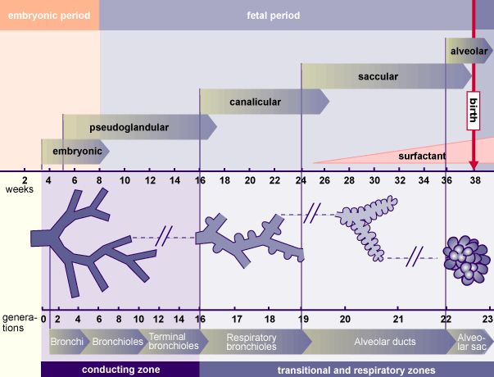
Introduction – Lung development in the fetus and neonate
http://img.aws.ehowcdn.com/intl-135m135/ds-cdn-write/upload//4000/000/50/4/294054.gif
Notes:
Where is this adapted from?

Slide 6
Introduction – Lung development in the fetus and neonate
http://www.ccneo.net/images/images%20bioethics%20working/lung%20development.jpg

Slide 7
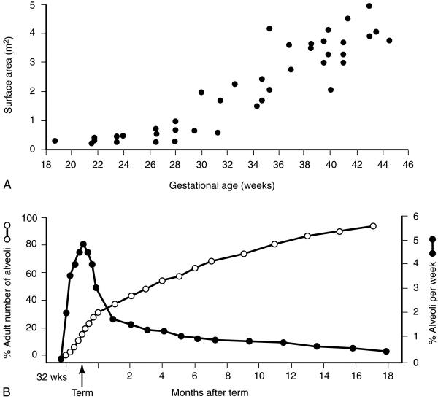
Introduction – Lung development in the fetus and neonate
Bulk Alveolarization occurs at 32 weeks
Peak gain of new alveoli
Rapid increase in alveolar surface area available for gas exchange

Slide 8
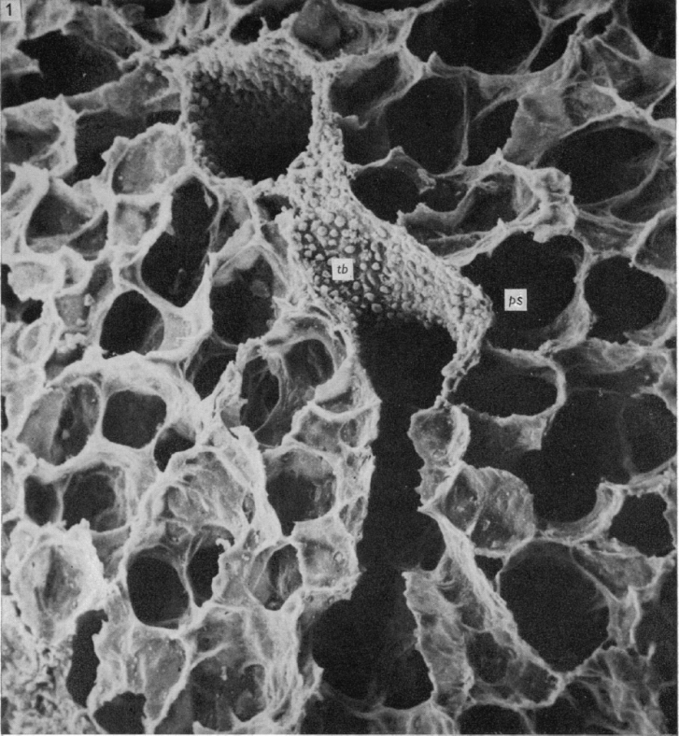
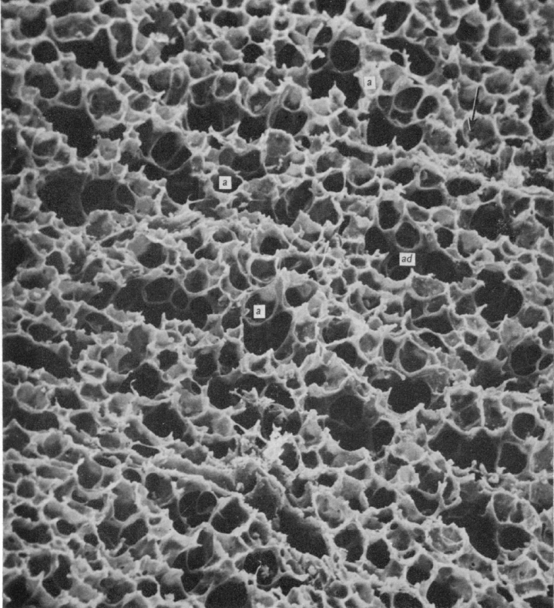
Introduction – Lung development in the fetus and neonate
SEM x300
Left: Day 1 mouse
Right: day 14 mouse

Slide 9
Introduction – Lung development in the fetus and neonate
When born prematurely, lung development is altered
Can give rise to bronchopulmonary dysplasia (BPD)
Normal fetal lung development depends on presence of amniotic fluid

Slide 10
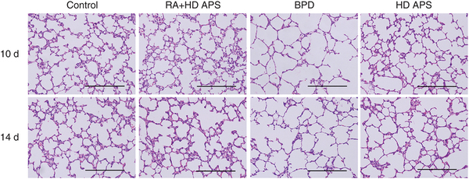
Bronchopulmonary dysplasia
Notes:
At its extreme, the altered lung development in preterm infants can give rise to a phenomenon called bronchopulmonary dysplasia. Simplified alveolar architecture, decreased alveolar surface area, similar to that seen in adult emphysema.

Slide 11
bronchopulmonary dysplasia - definition
BPD, defined as O₂ dependency at 36 weeks PMA, is a chronic lung disorder, common among preterm infants who received prolonged mechanical ventilation
Previous definition of respiratory support at 28 days is now combined with the above to define severity of BPD (mild, moderate, severe)

Slide 12
Bronchopulmonary dysplasia - prevalence
National Institutes of Child Health and Development (NICHD) Neonatal Network Data
2003-2007: 68% percent of premature infants 22-28 weeks gestation age with BPD
27% mild, 23% moderate, 18% severe
29,000 - all births in US in 2013 < 28 weeks gestation (CDC)

Slide 13
Bronchopulmonary dysplasia - morbidity
Increased risk for wheezing, asthma, and increased hospitalizations
Increased health care utilization – many physicians involved, many services needed to assist in development (PT/OT, Speech therapy)
Can also be a cause of adult disease states
Airway obstruction, reactive airways, emphysema
Can also affect growth and neurodevelopment
Also affects cardiovascular health
Pulmonary arterial hypertension, heart failure, systemic hypertension

Slide 14
Bronchopulmonary dysplasia - pathogenesis

Slide 15
Bronchopulmonary Dysplasia - Prevention
Few successes, many failures
RCTs: pharmacologic treatments, respiratory care practices, fluid and nutritional therapies, evidence-based bundled care practices
Three medications have shown efficacy in preventing BPD
Caffeine (Schmidt et al, 2006, 2007)
Vitamin A (Tyson et al, 1999)
Postnatal corticosteroids (Doyle et al, 2007)
Notable negative pharmacologic interventions: early iNO, superoxide dismutase, glutathione, cimetidine

Slide 16
bronchopulmonary dysplasia - prevention
Adapted from Schmidt, 2008

Slide 17
Continuous positive airway pressure (CPAp)
First described in the 1970s, demonstrating decreased mortality
“Gentle” ventilation that is proposed to cause less damage to the lungs compared with mechanical ventilation
More recently, 1990s-2000s, SUPPORT, COT, and BOOST trials all support the use of CPAP at birth over intubation/surfactant.

Slide 18
Cpap or intubation?

Slide 19
Why cpap?
Mimics natural response of grunting
Reduces tachypnea and increases functional residual capacity (FRC) and reduces pCO2
Decreases intrapulmonary shunting
Increases lung compliance
Stabilizes floppy infant chest wall
Reduces level of inspiratory work of breathing and labored breathing index
Reduces level of central apnea
Early CPAP in animal models has been shown to decrease proinflammatory cytokines

Slide 20
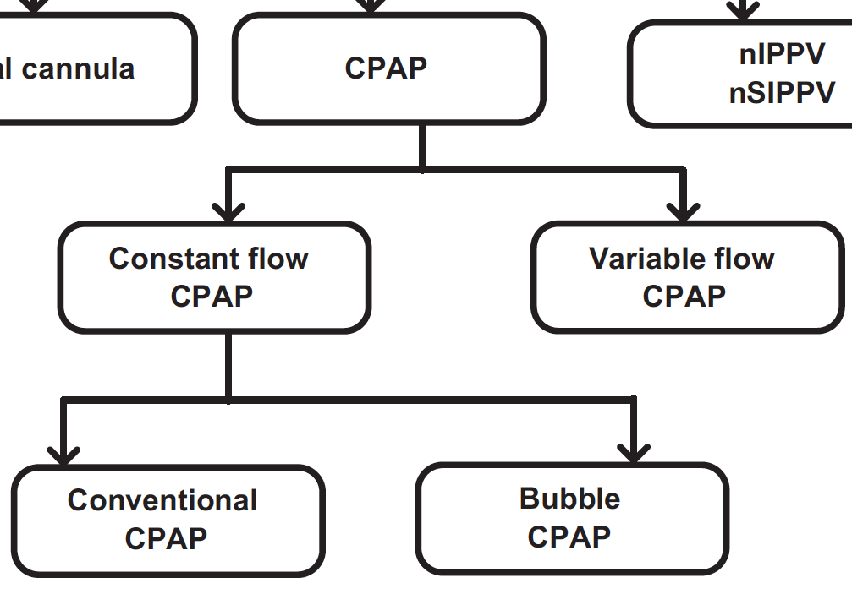
Types of cpap

Slide 21
Constant Flow cpap – conventional
Positive end expiratory pressure delivered via endotracheal tube
Benefits:
If intubated, no need to extubate if want to trial PEEP
Courtney et al (2010) suggests no difference in respiratory parameters between ventilator-generated CPAP and bubble CPAP
Disadvantages:
Intubated – associated risks vs bubble CPAP
Potentially increased length of stay (Bahman-Bijari et al, 2011)
May have worse rates regarding extubation failure (Gupta et al, 2012)

Slide 22
Constant flow cpap - conventional

Slide 23
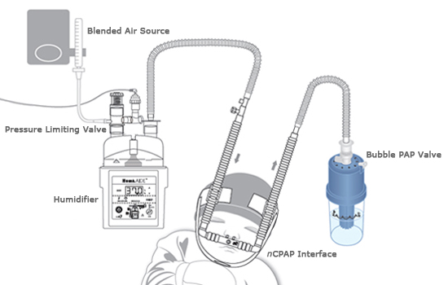
Constant flow cpap – bubble CPAP
“Gold standard” of non-invasive ventilation
Developed in the 1970s by Dr. Wung, anesthesiologist at Columbia University

Slide 24
bubble cpap - history
1968: Significance of grunting described (Benveniste et al)
1971: Use of CPAP introduced (Gregory et al)
1973: Decreased mortality reported with CPAP
1975: Use of nasal CPAP reported (Wung et al)
1976: CPAP regularized infants’ respiratory pattern and prevented apnea (Saunders et al)
1980s-90s: Improvement in neonatal ventilation and advent of surfactant decreased use of CPAP (proposed “golden drug” that would eliminate BPD)
1990s-2000s: Major trials suggested equal effectiveness of CPAP vs intubation/surfactant

Slide 25
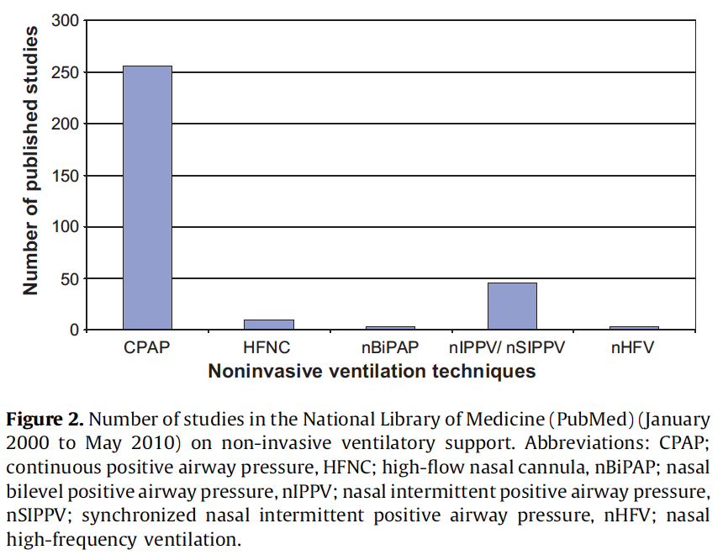
Bubble cpap - benefits
Relatively simple setup
Cost – use of bubble CPAP worldwide
Well studied over the past 5 decades
Other benefits of CPAP described earlier
Bubble CPAP in particular, producing small vibrations by its nature, could help in lung recruitment, and reduce minute ventilation without increasing pCO2 (Lee et al, 1998; Pillow et al, 2007)

Slide 26
Bubble cpap - disadvantages
More bulky and require more monitoring compared to heated, humidified high flow nasal cannula systems (HHFNC)
Gastrointestinal distension
Nasal septum breakdown
Delaying initiation of oral feedings
Does not happen at OHSU
Interference with maternal/paternal child bonding
Does not happen at OHSU

Slide 27
Bubble cpap – mask vs prongs?
Prongs well known to have potential for nasal septal breakdown
Masks avoid this issue, but bring up other points of breakdown due to pressure on other areas of the nose (ie. Nasal bridge). Kiernan et al (2012) using second-generation nasal masks seem to have better results.
Can be more difficult to maintain seal

Slide 28
Bubble cpap – new possibilities
Lung development is influenced by many factors
Strain and stress promotes differentiation and septation in experimental animal models
McBride et al (1996) showed in immature ferrets that CPAP increased lung volume, mass, and cellularity

Slide 29
Bubble cpap – new possibilities
Evidence that distending pressure from amniotic fluid in utero contributes to alveolar and vascular development
Evidence that tracheal occlusion in animal models of congenital diaphragmatic hernia improve lung mass (Muensterer, 2012) and function (Jelin, 2011)

Slide 30
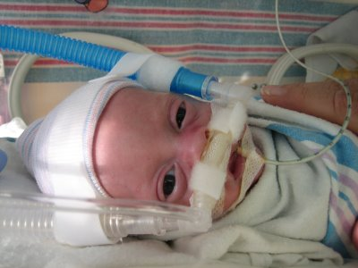
Bubble cpap – new possibilities
Xue et al demonstrated in animal models that CPAP decreased airway responsiveness and contractility, suggesting decreased inflammation
Tepper et al demonstrated that cyclic stretch of airway epithelial cells increases release of nitric oxide and placental growth factor, which can improve alveolarization
Picture from wordpress.com

Slide 31
How much cpap is enough?
There is little data available on how long CPAP should be continued in very low birth weight (VLBW) infants at risk for BPD
Also – early CPAP has mixed results regarding BPD prevention
There is variability between institutions and neonatologists about the optimal time to discontinue CPAP
Should the goal be to discontinue CPAP ASAP or is there a duration that will achieve maximum benefit?

Slide 32
One example – columbia university
Keeps infants on CPAP until close to discharge
Exclusively uses bubble CPAP
Lowest incidence of BPD in the country since the 1980s

Slide 33
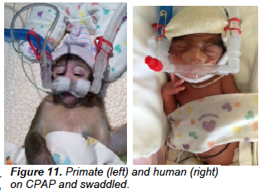
Oregon health & Science university
Conducting a study looking at the effects of duration of CPAP on pulmonary function testing in preterm infants
Also conducting a study at the Oregon National Primate Research Center looking at a similar model in non-human primates

Slide 34
Variable flow cpap
Different flows for inspiration and expiration, based on “fluidic flip” principle
Uses variable flow rate to maintain consistent CPAP delivery
Infant Flow SiPAP & Medijet are examples

Slide 35
Variable flow cpap - benefits
Some studies suggest easier work of breathing with variable flow CPAP systems (Liptsen et al 2005)
More consistent CPAP potentially delivered

Slide 36
Variable flow cpap - disadvantages
Proprietary equipment
Some studies suggest devices are loud (90 dB)
Conflicting studies on whether outcomes are better than bubble CPAP (Gupta et al 2009) – duration of support, extubation failure
Still requires a tight seal similar to bubble CPAP

Slide 37
Non-invasive ventilatory support - evidence

Slide 38
Low flow nasal cannula
Does not provide any distending pressure
Possible uses typically include those infants with established (likely mild) BPD that require some oxygen in order to convalesce at home
Not used in the treatment of RDS

Slide 39
High flow nasal cannula
Use of high flows of air or blended oxygen (>1Lpm) to support infant’s ventilation need
Typically heated and humidified (ie. HHHFNC)
Fisher & Paykel and Vapotherm are typical systems
RAM Cannula can potentially augment the distending pressure delivered
More studied needed to examine this

Slide 40
High flow nasal cannula - benefits
Use of simple nasal cannula for delivery
Much easier for day-to-day management of infant care
RAM Cannula with larger prong diameter, could potentially deliver CPAP without bulkiness of other systems.
Can deliver higher humidity than CPAP setups (Chang et al 2011)

Slide 41
High flow nasal cannula - benefits
Some studies suggest that HFNC improved work of breathing by several mechanisms:
Reduction of inspiratory resistance (Saslow et al 2006)
Washout of nasopharyngeal dead space (Frizzola et al 2011)
Provision of positive airway distending pressure (Locke et al 1992; Sreenan et al 2001)

Slide 42
High flow nasal cannula - benefits
Two studies (Shoemaker et al, 2007; Holleman-Duray et al, 2007) suggest earlier extubation, less ventilation days
Both studies retrospective and can have significant bias
Shoemaker study also suggests similar outcomes (death/BPD) to CPAP
Several other randomized trials suggest similar rates of postextubation failure in HFNC as compared to CPAP

Slide 43
High flow nasal cannula - disadvantages
Delivered distending pressure is variable (Locke et al, 1993)
Higher pressures can be delivered, but require tight fitting prongs, higher flow rates, closed mouth (ie. sounds like CPAP) (Locke et al, 1993)
Risk of overdistention if prongs too tight (though has been addressed).
No large randomized safety trials have been conducted

Slide 44
High flow nasal cannula – Future?
There remains the question of research demonstrating potential for improved lung growth using constant distending pressure
Future studies (including the one at OHSU) could potentially change how we view respiratory support vs growth in the NICU

Slide 45
Non-invasive ventilatory support - evidence

Slide 46
Non-invasive positive pressure ventilation
Provides positive pressure breaths on top of CPAP
Idea is to help with ventilation as a “bridge” to prevent intubation or failure of extubation
Similar to providing continuous PPV

Slide 47
Non-invasive positive pressure ventilation - benefits
Can be used with any ventilator
Could trigger an augmented inspiratory reflex (Head’s paradoxical reflex) in preterm infants
Studies in piglet models of RDS suggests less lung inflammation than intermittent mandatory ventilation via ET tube (Lampland et al, 2008)
Short periods (4-6h) of NIPPV appears to improve apnea of prematurity

Slide 48
Non-invasive positive pressure ventilation - benefits
Studies suggest that use of NIPPV does improve success of extubation, confirming the “bridge” idea
One study so far doesn’t show any difference in rates of necrotizing enterocolitis (NEC) with use of NIPPV (Davis et al, 2001)

Slide 49
Non-invasive positive pressure ventilation - disadvantages
Studies seem to show no difference in survival or BPD (Kirpalani et al 2013)
No studies have been powered sufficiently to properly assess safety (intestinal perforation, septum erosion/trauma)
As a primary treatment for RDS or apnea of prematurity, no superiority in outcomes compared with nCPAP

Slide 50
Bi-level or Biphasic CPAP
Provides 2 levels of CPAP via nasal prongs or facemask
Cycled usually every second between baseline CPAP and a higher level
Different from NIPPV in that pressures typically lower, as if someone is changing CPAP levels every second
Some hybrid modes that make them similar

Slide 51
Bi-level cpap - benefits
Studies appear to favor BiPAP in decreasing work of breathing compared to CPAP (Joshi et al, 2007)
Also appears to demonstrate shorter duration of respiratory support vs CPAP (Lista et al, 2010)

Slide 52
BI-LEVEL CPAP - DISADVANTAGES
Lack of safety studies
Lack of effectiveness studies
2 RCTs to date
Extubation failure rates not different between Biphasic CPAP and nCPAP
No data whether Biphasic CPAP helps with apnea of prematurity

Slide 53
summary
Prevention of BPD by providing distending pressure non-invasively is the primary goal
There are many forms of non-invasive ventilation that appear to have similar outcomes to gold standard of bubble CPAP
However, distending pressure not consistent, and safety studies need to be performed
Future studies looking into distending pressure for lung growth

Slide 54
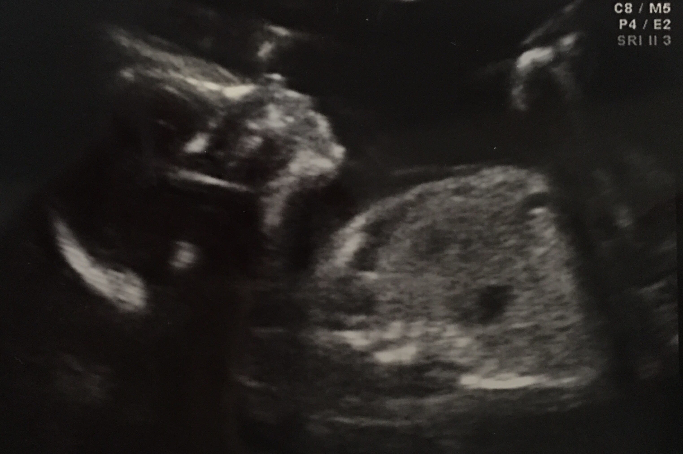
Thank you!

