Slide 1
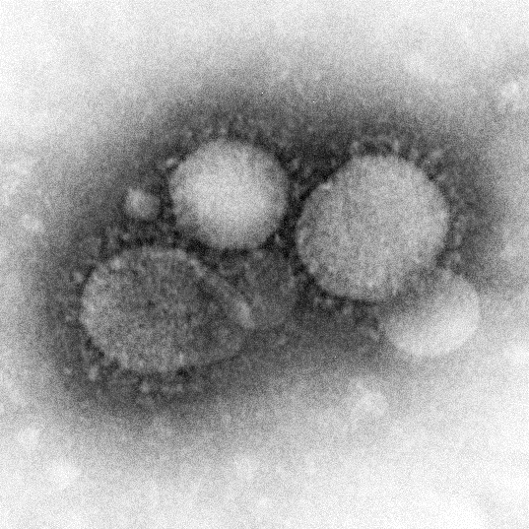
MERS-CoV (Middle East Respiratory Syndrome-Coronavirus)
Oregon Society for Respiratory Care Annual Conference
March 2, 2016
Carl Eckrode, Ph.D., MPH, RRT

Slide 2
OverVIEW
Background-The History of MERS
Epidemiology of MERS-Person, Place and Time
Clinical Features and Presentation-What are you looking at?
Treatment-I’ll Take Mechanical Ventilation for $1000, Alex
Questions?

Slide 3
DISCLAIMERS
I have no conflicts of interest
The opinions and statements of the presenter do not reflect those of his employer or the Oregon Society for Respiratory Care
But they should

Slide 4
BACKGROUND
During the summer of 2012, in Jeddah, Saudi Arabia, A coronavirus (CoV) was isolated from the sputum of a patient with pneumonia and renal failure
The isolate was provisionally called human coronavirus Erasmus Medical Center (EMC).
In September 2012, the same type of virus, re-named human coronavirus England 1, was recovered from a patient with severe respiratory illness who had been transferred from the Middle East to London

Slide 5
Background
The emergence of the disease was traced back to an even earlier time point.
in April 2012, a cluster of pneumonia cases in health care workers had occurred in an intensive care unit in Zarqa, Jordan
Two persons died, both of whom were confirmed to have been infected with the novel coronavirus through a retrospective analysis of stored samples

Slide 6
background
Middle East respiratory syndrome coronavirus (MERS-CoV) is a lineage C betacoronavirus found in humans and camels that is different from the other human betacoronaviruses (severe acute respiratory syndrome coronavirus, OC43, and HKU1) but closely related to several bat coronaviruses
In a cell line susceptibility study, MERS-CoV infected several human cell lines, including lower (but not upper) respiratory, kidney, intestinal, and liver cells
MERS-CoV can also infect nonhuman primates, pigs, bats, civets, rabbits, and horses

Slide 7
SO WHAT?

Slide 8
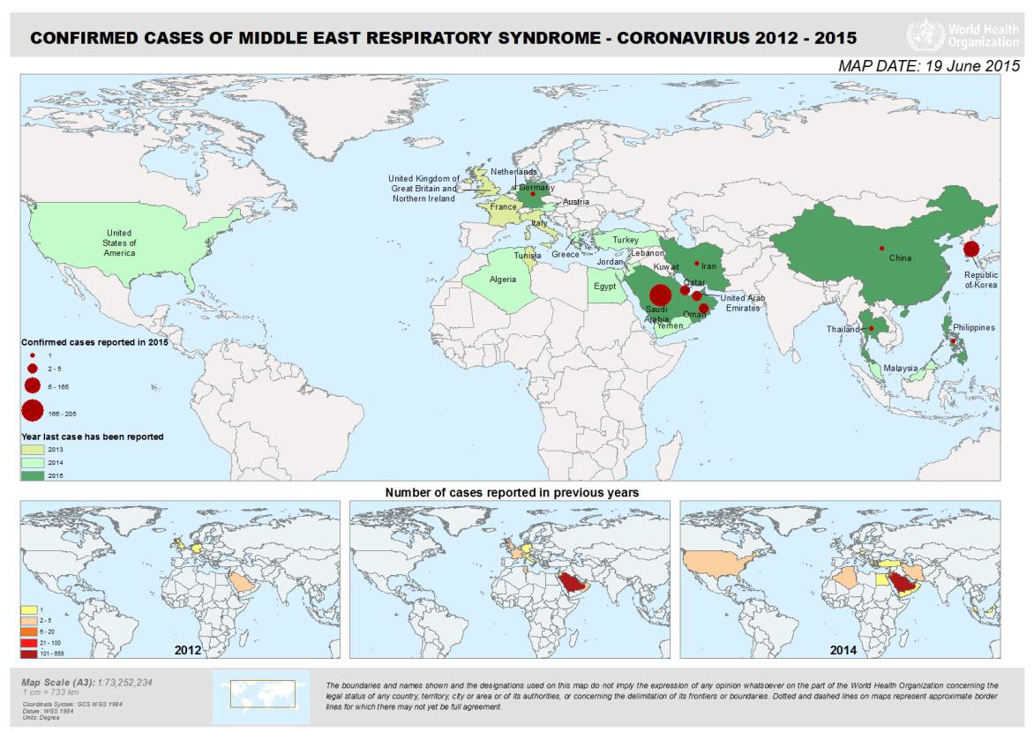
It’s a Small World, After ALL

Slide 9
It’s a Small World, After ALL
cases of MERS have been identified in Egypt, Iran, Jordan, Kuwait, Lebanon, Oman, Qatar, Saudi Arabia (KSA), United Arab Emirates (UAE), Yemen, Algeria, Tunisia, Austria, France, Germany, Greece, Italy, the Netherlands, Turkey, United Kingdom, China, the Republic of Korea , Malaysia, Philippines, Thailand and the United States of America (USA).

Slide 10
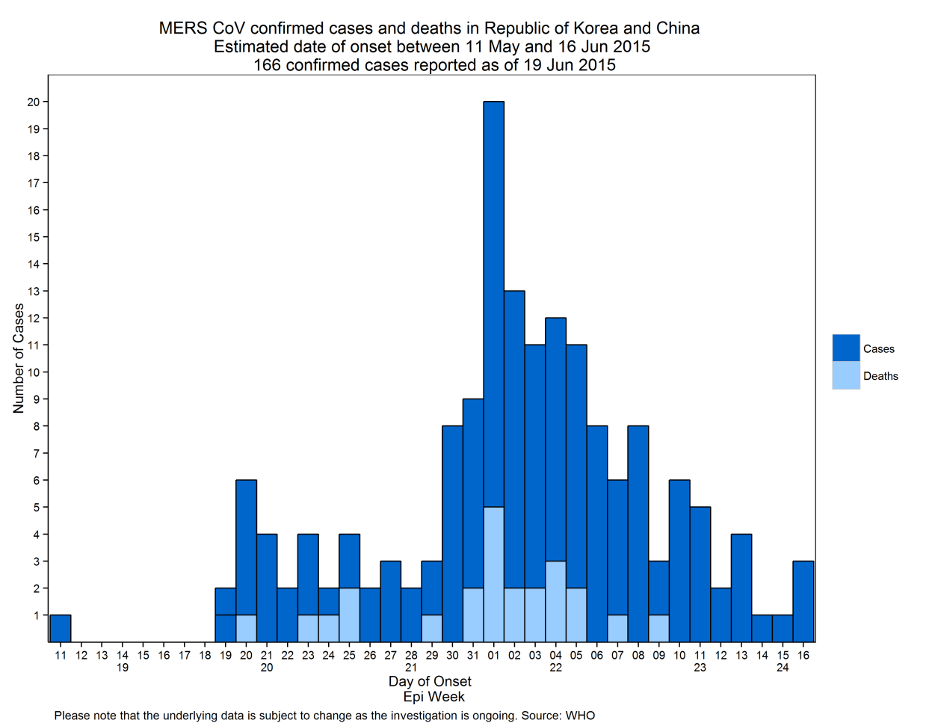
It’s a Small World, After ALL

Slide 11
It’s a Small World, After ALL
The outbreak in the Republic of Korea involved 72 health care facilities
6 health care facilities documented nosocomial transmission.
There were three large clustering events involving “Hospital B” (Pyeongteak St Mary’s Hospital), “Hospital D” (Samsung Medical Center) and one case (“Case 16”) who seeded two smaller outbreaks in Hospital E (Dae Cheong Hospital) and F (KonYang University Hospital).
This was the largest outbreak of MERS outside the Middle East. Since the identification of the first laboratory confirmed case, aggressive contact tracing was instituted and as of 19 June 2015, more than 10,000 contacts were followed and isolated at home or in state-run facilities.

Slide 12
EPIDEMIOLOGY
Gender: 66% of cases are male
Median age is 49 years old (range 9 months-94 years old)
Primary < secondary cases

Slide 13
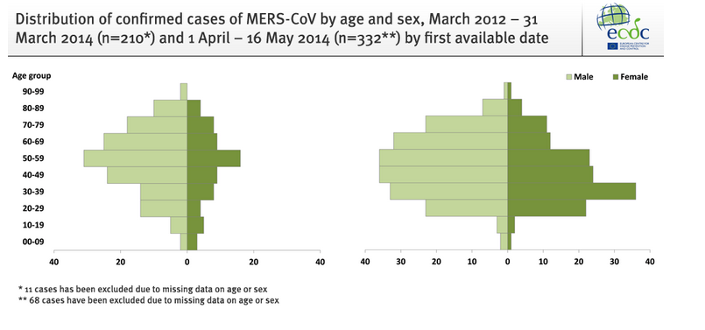
EPIDEMIOLOGY

Slide 14
EPIDEMIOLOGY
Characteristic | Primary Cases | Secondary Cases
N= | 98 | 204
Median age in years (range) | 57.5 (2-90) | 39 (9m-94)
% of male cases | 80% (78/97) | 56% (111/198)
% of cases with ≥1 underlying condition reported | 84% (74/88) | 69% (66/96)
% of cases classified as fatal | 83% (48/58) | 45% (33/74)
% Severe | 91% (88/97) | 27% (53/198)
% Asymptomatic | 0 | 42% (84/198)
% Health care workers | 5% (2/41) | 63% (93/147)
% reported contact with camels | 33% (23/70) | 9% (3/32)

Slide 15
EPIDEMIOLOGY
As of 11 February 2016, the World Health Organization (WHO) global case count for MERS was 1,638 laboratory-confirmed cases, including at least 587 deaths (case fatality rate 36%)
All cases of MERS world-wide have had a history of residence in or travel to the Middle East (mainly Saudi Arabia), or contact with travelers returning from these areas, or can be linked to an initial imported case.
Camels are suspected to be the primary source of infection for humans, but the exact routes of direct or indirect exposure are not fully understood, and further studies (particularly case control studies) are needed.
There is no evidence of ongoing community transmission in any country and only occasional instances of household transmission.
Transmission in health care settings has been a feature of the outbreak.

Slide 16
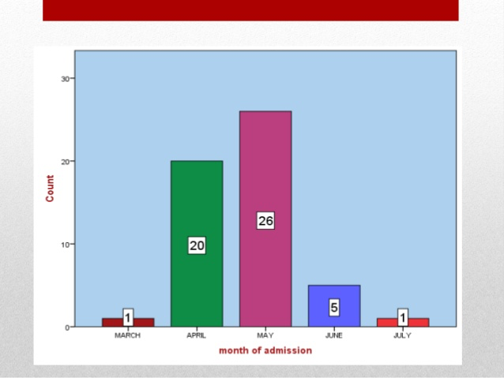
EPIDEMIOLOGY

Slide 18
EPIDEMIOLOGY
New infections continue, including some cases for whom no clear exposure or source of infection can be identified.
MERS-CoV are thought to spread from person to person primarily through large-particle respiratory droplet transmission
Transmission via large-particle droplets requires close contact between source and recipient persons because droplets do not remain suspended in the air and generally travel only a short distance (<6 feet).
Contact with contaminated surfaces is another source of transmission

Slide 19
EPIDEMIOLOGY
The median incubation period for secondary cases associated with limited human-to-human transmission is approximately 5 days (range 2-14 days).
In MERS-CoV patients, the median time from illness onset to hospitalization is approximately 4 days.
In critically ill patients, the median time from onset to intensive care unit (ICU) admission is approximately 5 days, and median time from onset to death is approximately 12 days.
In one series of 12 ICU patients, the median duration of mechanical ventilation was 16 days, and median ICU length of stay was 30 days, with 58% mortality at 90 days.

Slide 20
EPIDEMIOLOGY
Several factors appear to have contributed to the initial spread of this virus.
The appearance of MERS-CoV was unexpected and unfamiliar to most clinicians
Infection prevention and control measures in hospitals were not optimal
Extremely crowded Emergency Rooms and multi-bed rooms contributed significantly to nosocomial infection in some hospitals.
The practice of seeking care at a number of medical facilities (“doctor shopping”) may have been a contributing factor
The custom of having many friends and family members accompanying or visiting patients may have contributed to secondary spread of infection among contacts.

Slide 21
EPIDEMIOLOGY
A recent study found that in healthcare settings, a short period without protective equipment may be sufficient for transmission
a security guard in the RoK who was within 3 to 6 feet of a fatally-ill patient for 10 minutes without a mask, and without touching the patient, acquired the infection.
The potential for transmission from asymptomatic (but PCR positive) people is currently unclear.
However, there is evidence of asymptomatic carriage of the virus.
The estimated incubation period is unknown and currently is considered to be up to 14 days (2-14).

Slide 22
CLINICAL PRESENTATION
Typical early symptoms include fever, cough, chills, and shortness of breath. Pneumonia is common. Some cases have had diarrhea, nausea, or vomiting.
Other cases tested after their contact with MERS patients have had no symptoms.
Complications of MERS include ARDS and MOSF.
Most severe cases of MERS have had underlying chronic medical conditions.
There is no known vaccine (for humans) or specific drug therapy

Slide 23
CLINICAL PRESENTATION
Radiographic findings may include unilateral or bilateral patchy densities or opacities, interstitial infiltrates, consolidation, and pleural effusions.

Slide 24
CLINICAL PRESENTATION
Rapid progression to acute respiratory failure, acute respiratory distress syndrome (ARDS), refractory hypoxemia, and extrapulmonary complications (acute kidney injury requiring dialysis, hypotension requiring vasopressors, hepatic inflammation, septic shock) has been reported.

Slide 25
CLINICAL PRESENTATION
Laboratory findings at admission may include leukopenia, lymphopenia, thrombocytopenia, and elevated lactate levels.
Co-infection with other respiratory viruses and a few cases of co-infection with community-acquired bacteria at admission has been reported
MERS-CoV virus can be detected with higher viral load and longer duration in the lower respiratory tract compared to the upper respiratory tract, and has been detected in feces, serum, and urine.
However, very limited data are available on the duration of respiratory and extrapulmonary MERS-CoV shedding.

Slide 26
CLINICAL PRESENTATION
On 14 September 2012, the United Kingdom Health Protection Agency (HPA) Imported Fever Service was notified of a case of unexplained severe respiratory illness in a London intensive care unit.
The patient had recently transferred from Qatar and had a history of travel to Saudi Arabia.
He was a previously well 49 year-old man who developed a mild undiagnosed respiratory illness while visiting Saudi Arabia during August 2012, which fully resolved. He subsequently presented to a physician in Qatar on 3 September, with cough, myalgia and Arthralgia, and was prescribed oral antibiotics.
Five days later, he was admitted to a Qatari hospital with fever (38.4 °C) and hypoxia, with oxygen saturation of 91% on room air.
A chest X-ray showed bilateral lower zone consolidation. He was treated with ceftriaxone,

Slide 27
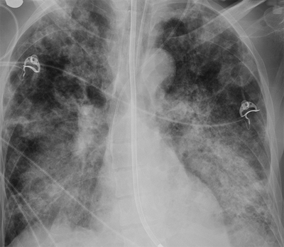
CLINICAL PRESENTATION

Slide 28
CLINICAL PRESENTATION
After 48 hours, he required intubation and ventilation and was transferred by air ambulance to London.
On admission to intensive care in London, he remained severely hypoxic, achieving an arterial PaO2 of 6.5 kPA (normal range: 11–13 kPA) on 100% oxygen with pressure-controlled ventilation, and required low-dose norepinephrine to maintain blood pressure.
His white blood cell count was 9.1 x 109/L (normal range: 4–11 x 109/L), C-reactive protein 350 mg/L (normal range: 0–10 mg/L) and creatinine 353 μmol/L (normal range: 53–97μmol/L), with normal liver function and coagulation.
He was treated with corticosteroids and broad-spectrum antibiotics, initially meropenem, clarithromycin and teicoplanin. Colistin and liposomal amphotericin B were subsequently added.
His condition deteriorated between 11 and 20 September, with progressive hypoxia. His C-reactive protein level peaked at 440 mg/L and procalcitonin at68 ng/ml (normal level: <0.5 ng/ml).

Slide 29
CLINICAL PRESENTATION
His renal function worsened and dialysis was initiated on 14 September.
20 September (day 17 of illness), extracorporeal membrane oxygenation (ECMO) was started.
As of 2 October, he remained stable but fully dependent on ECMO after 13 days (day 30 of illness).

Slide 30
TREATMENT
The most important recommendation remains that high quality supportive care is the keystone of management, as expressed in the updated WHO Interim Guidance on MERS: http://www.who.int/csr/disease/coronavirus_infections/case-management-ipc/en

Slide 31
TREATMENT
As with other coronaviruses, no antiviral agents are recommended for the treatment of Middle East respiratory syndrome coronavirus (MERS-CoV) infection.
Ribivirin not effective in the clinical setting
Use of interferon appears equally ineffective

Slide 32
TREATMENT
Mechanical ventilation using lung-protective strategies
ECMO?

Slide 33
TREATMENT

Slide 34
References/sources
1. World Health Organization. Middle East respiratory syndrome coronavirus (MERS-CoV) - updates 23 September 2012 to 6 January 2016. 2015.
2. Kim T JJ, Kim SM, Seo DW, Lee YS, Kim WY, Lim KS, Sung H, Kim M, Chong YP, Lee SO, Choi SH, Kim YS, Woo JH, Kim SH. Transmission among health care worker contacts with a Middle East respiratory syndrome patient in a single Korean center. Clin Microbiol Infect 15 September 2015.
3. Memish ZA, Assiri AM, Al-Tawfiq JA. Middle East respiratory syndrome coronavirus (MERS-CoV) viral shedding in the respiratory tract: an observational analysis with infection control implications. Int J Infect Dis 2014;29:307-308.

Slide 35
References/sources
4. Al-Gethamy M, Corman VM, Hussain R, Al-Tawfiq JA, Drosten C, Memish ZA. A case of long-term excretion and subclinical infection with MERS-Coronavirus in a health care worker. Clin Infect Dis 2014.
5. Drosten C, Meyer B, Müller MA, Corman VM, Al-Masri M, Hossain R, et al. Transmission of MERS-Coronavirus in Household Contacts. New England Journal of Medicine 2014;371(9).
6. Lipkin WI. Middle East Respiratory Syndrome Coronavirus Recombination and the Evolution of Science and Public Health in China.8 September 2015 mBio vol. 6 no. 5 e01381-15.

Slide 36
References/sources
7. World Health Organization. WHO Risk Assessment, Middle East respiratory syndrome coronavirus (MERS-CoV) 2014.
8. Wood R, Donaghy M, Dundas S. Monitoring patients in the community with suspected Escherichia coli 0157 infection during a large outbreak in Scotland in 1996. Epidemiol Infect 2001;127:413-420.
9. World Health Organization. Middle East respiratory syndrome coronavirus (MERS-CoV) - update 29 November 2013. 2013.

Slide 37
References/sources
10. Meyer B MM, Corman VM, Reusken CBEM, Ritz D, Godeke G-D, et al.,. Antibodies against MERS coronavirus in dromedary camels, United Arab Emirates, 2003 and 2013. Emerg Infect Dis [Internet]. 2014 Apr .
11. Alagaili AN, Briese T, Mishra N, Kapoor V, Sameroff SC, de Wit E, et al. Middle East respiratory syndrome coronavirus infection in dromedary camels in saudi arabia. MBio 2014;5(2).
12. Chu DKW PL, Gomaa MM, Shehata MM, Perera RAPM, Zeid DA, et al.,. MERS coronaviruses in dromedary camels, Egypt. Emerg Infect Dis [Internet]. 2014 Jun.

Slide 38
References/sources
12. Danielsson N, Team EIR, Catchpole M. Novel coronavirus associated with severe respiratory disease: case definition and public health measures. Euro Surveill 2012;17(39).
13. Zaki AM, van Boheemen S, Bestebroer TM, Osterhaus AD, Fouchier RA. Isolation of a novel coronavirus from a man with pneumonia in Saudi Arabia. N Engl J Med 2012;367:1814–20.
14. case of severe lower respiratory tract disease associated with a novel coronavirus—February 11, 2013. Stockholm, Sweden: European Centre for Disease Prevention and Control; 2013. Available at http://www.ecdc.europa.eu/en/press/news/lists/news/ecdc_dispform.aspx?list=32e43ee8%2de230%2d4424%2da783%2d85742124029a&id=841&rootfolder=%2fen%2fpress%2fnews%2flists%2fnews.
Available at http://www.hpa.org.uk/newscentre/nationalpressreleases.

Slide 39
References/sources
15. Health Protection Agency. Update on family cluster of novel coronavirus infection in the UK. London, United Kingdom: Health Protection Agency; 2013. Available at http://www.hpa.org.uk/newscentre/nationalpressreleases.
16. Health Protection Agency. Case of novel coronavirus identified in the UK. London, United Kingdom: Health Protection Agency; 2013. Available at http://www.hpa.org.uk/newscentre/nationalpressreleases.
17. European Centre for Disease Prevention and Control. Epidemiological update: case of severe lower respiratory tract disease associated with a novel coronavirus—February 11, 2013. Stockholm, Sweden: European Centre for Disease Prevention and Control; 2013. Available at http://www.ecdc.europa.eu/en/press/news/lists/news/ecdc_dispform.aspx?list=32e43ee8%2de230%2d4424%2da783%2d85742124029a&id=841&rootfolder=%2fen%2fpress%2fnews%2flists%2fnews.

Slide 40
References/sources
19. Health Protection Agency. Further UK case of novel coronavirus. London, United Kingdom: Health Protection Agency; 2013. Available at http://www.hpa.org.uk/newscentre/nationalpressreleases.
20. Health Protection Agency. Third case of novel coronavirus infection identified in family cluster. London, United Kingdom: Health Protection Agency; 2013. Available at http://www.hpa.org.uk/newscentre/nationalpressreleases.
21. Cowling BJ, Park M, Fang VJ, Wu P, Leung GM, Wu JT. Preliminary epidemiological assessment of MERS-CoV outbreak in South Korea, May to June 2015. Euro Surveill. 2015;20(25)

Slide 41
References/sources
22. Reusken CB, Farag EA, Haagmans BL, Mohran KA, Godeke GJt, Raj S, et al. Occupational Exposure to Dromedaries and Risk for MERS-CoV Infection, Qatar, 2013-2014. Emerg Infect Dis 2015;21(8):1422-1425.
23. Haagmans BL, van den Brand JM, Raj VS, Volz A, Wohlsein P, Smits SL, et al. An orthopoxvirus-based vaccine reduces virus excretion after MERS-CoV infection in dromedary camels. Science 2016;351(6268):77-81.

Slide 42
References/sources
Centers for disease control and prevention, Atlanta, Georgia
European Centre for Disease Control and Prevention, solna, sweden
Republic of Korea Centers for Disease Control and Prevention – 질병관리본부, Osong-eup, Heungdeok-gu, Cheongju-si, Chungcheongbuk-do, Korea
Ministry of Health, King Fahd Hospital Jeddah, Kingdom of Saudi Arabia
Centers for infectious Disease Research and Policy, University of Minnesota-Twin Cities, Minneapolis, Minnesota

Slide 43
QUESTIONS?

